Slide 1




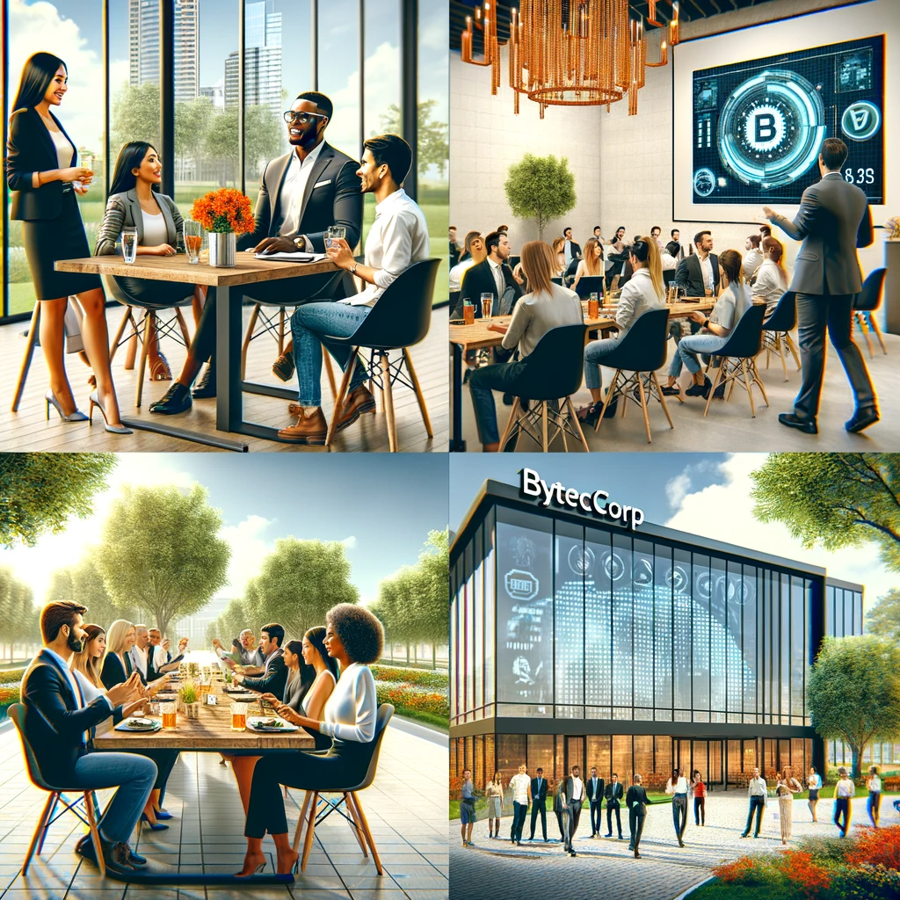


Innovative Leadership and Cultural Dynamics in Tech Startups: ByteCorp

Slide 2
Agenda
Initial Motivation
Founding Goals
Fundamental Core Values
Embracing Diversity
Funding And Investment
Business Growth and Clients
Engaging Clients
Data Management
Startup Challenges
Employee Trainings
Negotiation Tactics
Employee Retention
Resolving Conflicts
Leveraging AI Tools
Innovative Hiring
Innovative Leadership and Cultural Dynamics in Tech Startups

Slide 3
Motivation
Motivation
Goals
Core
values
diversity
What was the personal motivation for starting ByteCorp?
The decision to start ByteCorp was driven by the desire to break away from conventional career paths and embrace entrepreneurship. The motivation to start ByteCorp was fueled by a shared commitment to take risks, innovate, and create something meaningful, rather than pursuing traditional employment models.

Slide 4
Goals
Motivation
Goals
Core
values
diversity
What were the founding vision and goal of ByteCorp?
Technology-Centric Problem Solving: A vision and the founding goal was centered to work on cutting-edge technology , assisting multinational technical founders in creating products that embody modern technology and solving impactful problems across various industry sectors, prioritizing the use of modern technology to drive sustainable solutions.

Slide 5
Core values and diversity
What are the core values and culture of ByteCorp and how does ByteCorp approach diversity within the organization?
Emphasis on Transparency: ByteCorp fosters a culture of transparency in its interactions with both employees and clients, promoting open communication, ethical decision-making, and accountability. •
Diversity is not a forced goal : Diversity is seen as a natural outcome of the company's culture rather than a forced goal. The company has experienced a variety of cultural and religious demographics, including major religions like Islam and Hinduism in Pakistan. The emphasis is on learning and growth from the diverse cultural environment.
Motivation
Goals
Core
values
diversity

Slide 6
Employee health
How does Bytecorp approach the potential burnout of its employees and maintain a healthy work environment?
Priority on Individual Well-being: Bytecorp prioritizes individual well-being, offering flexibility in work styles, valuing mental and emotional health, and promoting a healthy work-life balance for its employees.
Motivation
Goals
Core
values
diversity

Slide 7
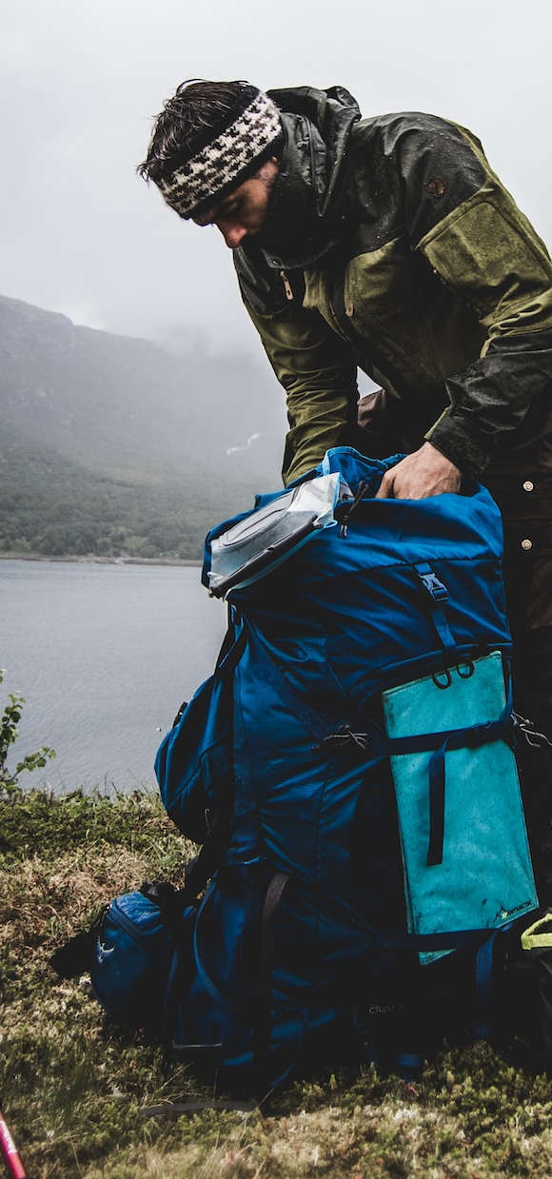
Funding
How has ByteCorp handled funding and investment decisions?
The company started with a small amount of funding, which eventually ran out. Despite this, they continued to push forward. The approach to funding is not black and white; it depends on the stage of the startup (e.g., pre-seed, seed) and the need for funding. Majority shareholders inevitably have a say in the company's direction.
Funding
Investment
Business
Client

Slide 8
Business growth and client engagement
What strategies does ByteCorp use for business growth and client engagement?
ByteCorp works closely with product founders and employs a pattern of generating business through partnerships, executing projects with a focus on profitability and effectiveness. The company adapts its approach based on the specific needs and characteristics of the projects and partnerships.
Funding
Investment
Business
Client

Slide 9
Alignment with Team Members' Working Styles
How does ByteCorp ensure alignment with its team members' personal working styles and preferences?
ByteCorp recognizes individual differences in work preferences, such as some people disliking meetings or preferring text-based communication. They try to align work responsibilities with these preferences, especially in roles like project management or business development, where certain communication styles are crucial.
Funding
Investment
Business
Client

Slide 10
Partnership and Sales
What are ByteCorp’s strategies for sustaining business partnerships and handling sales?
ByteCorp engages in consistent patterns of business generation and project execution in collaboration with their partners. They work on defining clear partnership terms, like sharing ratios (e.g., 60-40, 70-30), and adapt their strategies according to each partnership's unique requirements.
Funding
Investment
Business
Sales

Slide 11
Data breach
Data
Startup
Training
Negotiation
What is ByteCorp’s stance on handling unforeseen challenges or emergencies, such as a data breach?
While ByteCorp has not experienced a data breach, the company seems prepared to handle such emergencies. They have a knowledgeable security team and necessary protocols in place to address potential security issues effectively.

Slide 12
Startup
Data
Startup
Training
Negotiation
What mistakes should be avoided when starting a startup?
Focus on addressing a real problem rather than just using trendy technologies. Select your startup team carefully; working with friends can be beneficial if they are truly reliable and committed.

Slide 13
Training new employees
Data
Startup
Training
Negotiation
How do you handle hiring and training new employees?
Novice employees are trained by senior employees and experienced mentors. We also have external mentors and regular calls with them to ensure comprehensive training.

Slide 14
Partnership and Sales
Data
Startup
Training
Negotiation
What is your strategy for compensation and negotiation during recruitment?
ByteCorp engages in consistent patterns of business generation and project execution in collaboration with their partners. They work on defining clear partnership terms, like sharing ratios (e.g., 60-40, 70-30), and adapt their strategies according to each partnership's unique requirements.

Slide 15
Employee retention and contracts
Retention
Conflicts
AI tools
Hiring
What is your approach to employee retention and contracts?
We have a one-year binding clause but don't hold anyone against their will. It's important to treat employees professionally and respectfully, even when they choose to leave.

Slide 16
Conflicts Resolution among employees
Retention
Conflicts
AI tools
Hiring
Do you have any policies for handling conflicts in the workplace?
Our approach is to maintain a respectful and professional environment. We address conflicts through dialogue and, if necessary, formal measures, prioritizing the well-being of the majority of the team.

Slide 17
Usage of AI tools in work
What is your perspective on using AI tools like GPT in the workplace?
We believe in leveraging technology like GPT to enhance our work. There are no restrictions on using such tools as they can provide a competitive edge
Retention
Conflicts
AI tools
Hiring

Slide 18
Hiring process and Ideal candidate
How do you evaluate the potential and experience of candidates during interviews and How do you ensure you are hiring the right people for open positions?
We assess candidates based on their technical projects and their ability to explain and understand these projects deeply, not just superficially We look for candidates who are inquisitive and engaged in the interview process. A lack of questions from the candidate can be a red flag.
Retention
Conflicts
AI tools
Hiring

Slide 19
Thanks
Group Members
Sumsam Ali
Bahadur Khan
Taha Khan

